Slide 1
EDES 301 Pomodoro Timer Proposal
October 5, 2025
Paige Rennie

Slide 2
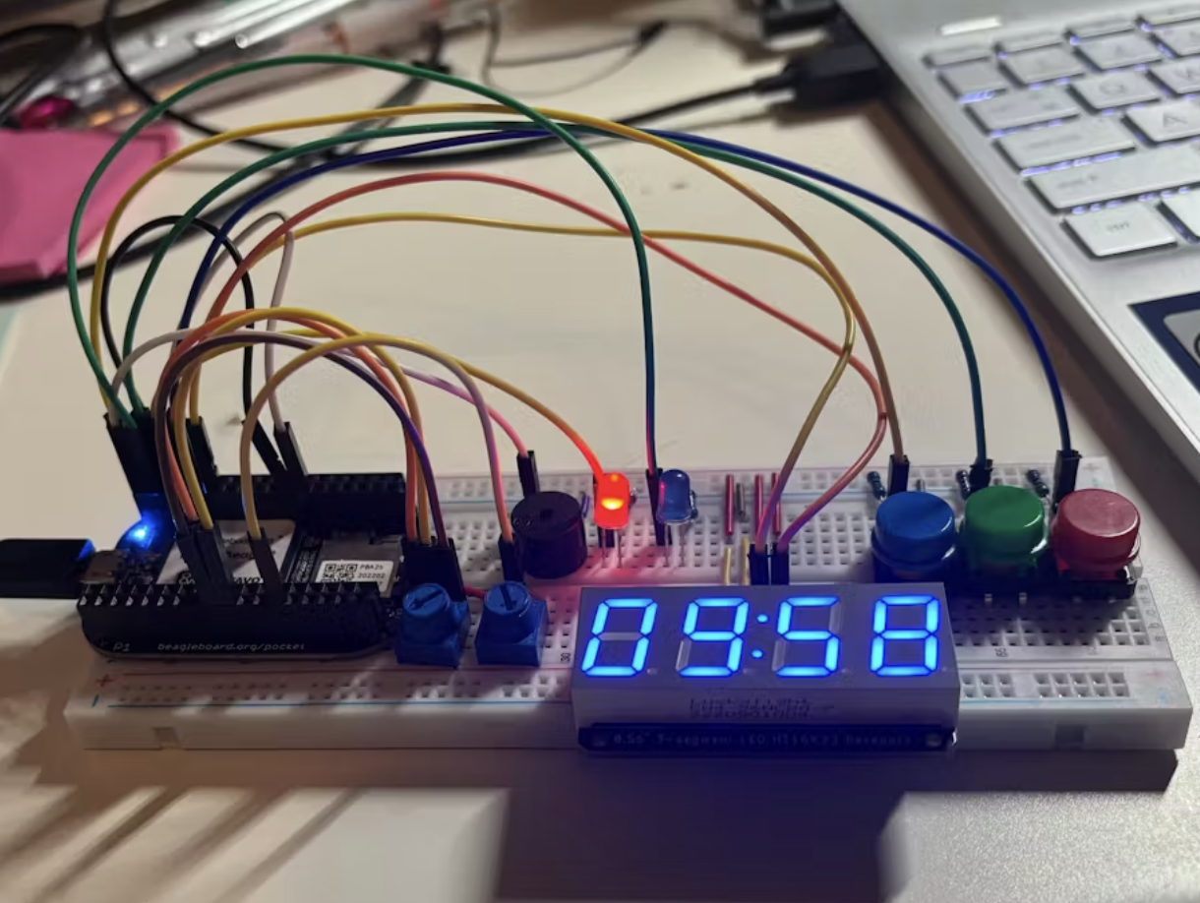
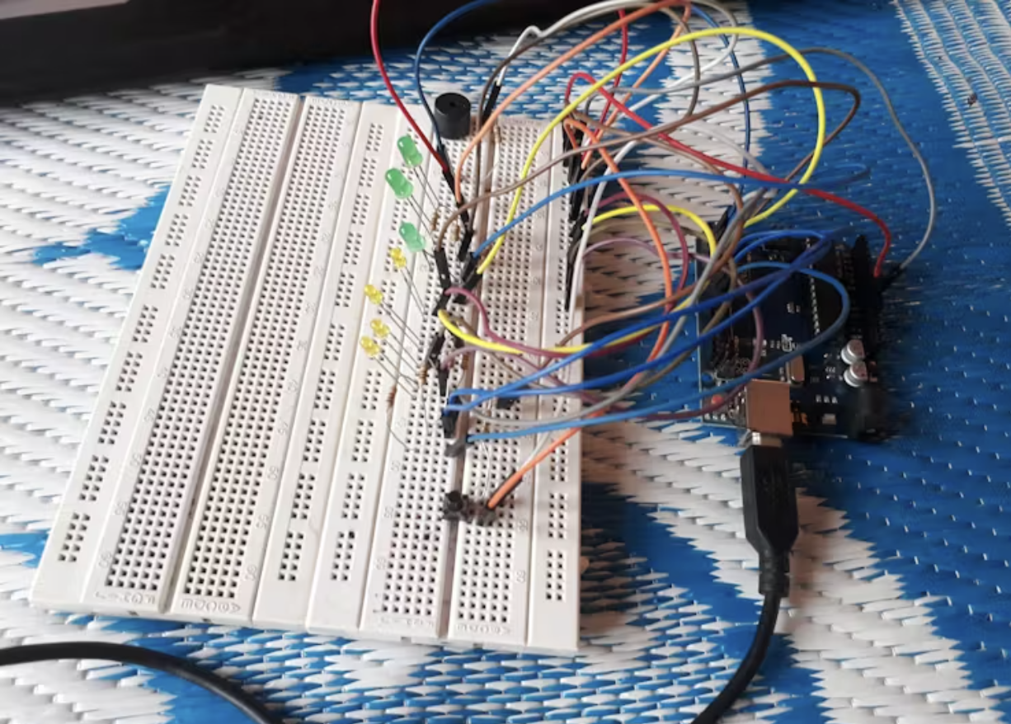
Background Information
What is being proposed?
I plan to make an adjustable Pomodoro based study/homework timer. It has been proven that if you study or do homework for shorter amounts of time with small breaks instead of trying to power through for hours in a row, you end up being able to concentrate for longer!
I can use my phone or laptop to do this but not having it displayed in front of me isn’t helpful. Also, sometimes I just need my phone to be away from me (out of sight, out of mind!) so having it on a device that isn’t attached to my phone would be helpful!
I would like to develop Amal Mathew’s project and Megan Enriquez’s study timer.
What improvements / additions over existing project
My plan is to combine the two project ideas to create an adjustable Pomodoro Timer. Sometimes my capacity to concentrate is longer than the typical 25 minutes for a Pomodoro Timer so I would like to create the ability to change that time whilst keeping the short break the same length.
Additionally, Amal’s project was completed using an Arduino so I will have to figure out how to integrate their idea into a Pocket Beagle.

Slide 3
System Block Diagram
Button
OSD335x-SM SiP
GPIO_44 (P8.12)
DGND (P8.2)
VDD_3V3 (P9.3)
GNDA_ADC (P9.34)
VDD_ADC (P9.32)
AIN1 (P9.40)
EHRPWMIA (P9.14)
DGND (P9.1)
VDD_3V3 (P9.4)
I2C2_SCL (P8.19)
I2C2_SDA (P8.20)
DGND (P8.1)
DGND (P9.2, all 4)
GPIO_88 (P8.28)
GPIO_89 (P8.30)
GPIO_11 (P8.32)
GPIO_81 (P8.34)
DGND (P9.2)
GPIO_77 (P8.40)
DGND (P9.2)
GPIO_75 (P8.42)
DGND (P9.2)
GPIO_73 (P8.44)
7 Segment LCD Display
HT16K33
Resistor
Resistor
Resistor
4 Green LEDs
Potentiometer
CYT1100
Resistor
Resistor
Resistor
Green LED
Resistor
Buzzer
HCW-KC1206
Red LED
Resistor
Resistor
White LED
Notes:
Think through user interface
Anything else you want to do
Ambiance, experience as enjoyable as possible for the user
Could play background music/suitable reward. Speaker, can play mp3s
Think about how the transitions work between study and break
User cues of 30 seconds left, maybe different buzzer sounds, fun sound effects, break vs back to work
Understanding time, real time clock, how to make time move faster for testing

Slide 4
Power Block Diagram
Key:
1.8V
3.3V
Button
OSD335x-SM SiP
GPIO_44 (P8.12)
DGND (P8.2)
VDD_3V3 (P9.3)
GNDA_ADC (P9.34)
VDD_ADC (P9.32)
AIN1 (P9.40)
EHRPWMIA (P9.14)
DGND (P9.1)
VDD_3V3 (P9.4)
I2C2_SCL (P8.19)
I2C2_SDA (P8.20)
DGND (P8.1)
DGND (P9.2, all 4)
GPIO_88 (P8.28)
GPIO_89 (P8.30)
GPIO_11 (P8.32)
GPIO_81 (P8.34)
DGND (P9.2)
GPIO_77 (P8.40)
DGND (P9.2)
GPIO_75 (P8.42)
DGND (P9.2)
GPIO_73 (P8.44)
7 Segment LCD Display
HT16K33
Max 420 mA (all segments lit, can also just do less current and will be less bright)
4 Green LEDs
Potentiometer
CYT1100
20 mA each (80 mA)
Green LED
20 mA
Buzzer
HCW-KC1206
30 mA
Red LED
20 mA
White LED
20 mA

Slide 5
Software Block Diagram
Each coded in a separate python block and called by main function
main_python_code.py
7-Segment Display
Default “off”
Wait for button press
On until turned off
Displays time whilst running
4x green LEDs
Default “off”
1x LED turns on per Pomodoro completed
green, red, white LEDs
Default “off”
1 of the 3 LEDs turns on dependent on stage in cycle
After 4th Pomodoro, press to start long break
Button
When pressed first time, turns system on
When pressed first time, turns system on (display)
When pressed second time, starts first Pomodoro
When pressed third time, starts break
Potentiometer
User rotates knob
Changes the time length for the Pomodoro study block
Repeat for a total of 4 Pomodoro cycles
Buzzer
Short buzz 1 min before end of Pomodoro and 30s before end of short
Buzzes a different pattern of sound at the end of each Pomodoro type

Slide 6
Components / Budget
Component | EDES301 to Buy? | Cost
7x LEDs | No (already have)
1x 7 segment LED display | No (already have)
Resistors | No (already have)
Male to male wires | No (already have)
1x button | No (already have)
1x buzzer | No (already have)
1x potentiometer (https://a.co/d/5DEaqHE) | Yes | $8.89
1x real time clock (adafruit) | Yes | $7.50
See Next Slide for Instructions

Slide 7
Component Selection (Remove slide for submission)
All components must be from either: Amazon, Adafruit, Sparkfun, Digi-Key, or Mouser
Select no more than two (2) components that are not on approved component spreadsheet
See Canvas 🡪 Files 🡪 assignments 🡪 EDES301_project_01_parts_list.xlsx
If there is a cheaper part that you would like to use, we can discuss in the project meeting
All components needed for the project should be listed on Slide 5
All components should have links to the website where they can be purchased
Please trim URLs for links to Amazon
EDES301 will supplement $25 to $35 dollars for components
Please indicate what components need to be purchased by EDES301
If you have a special request, we can discuss in the project meeting

